Slide 1
5 Reasons To Learn Python
Simon Stride

Slide 2
Spoiler alert
Python is fun!
Community & Resources
Solve the problem with less code
Diversity of solutions
Get better at what you already do

Slide 3


Everyone’s doing Python!
Hang on, just because something’s popular doesn’t mean it’s good!
But seriously, everyone’s doing Python these days…
Notes:
Here’s 5 reasons to consider learning Python!
Credit to my wife for this suggestion
Google, YouTube, Netflix,

Slide 4
1. Python is fun!
The Python community, libraries and ecosystem is filled with quirky humour and “Py*” related puns
The light-touch punctuation is liberating! Who needs semicolons anyway…
The high-level syntax means that, generally speaking, if you can articulate the problem in English, you’re > 50% there!
Spend less time worrying about constructs and get straight to solving the problem at hand

Slide 5
2. Community and Resources
The Python community is massive and growing
Free & paid resources e.g. RealPython.com
Podcasts
Talk Python To Me
Python Bytes
Python User Groups/Meetups (meetup.com)

Slide 6
3. Solve the problem with less code
“There’s a library for that…” – many problems have already been seen and tackled elsewhere
PyPI.org (Python Package Index) hosts software packages created and curated by the Python community
Install with pip – Python’s off-the-shelf package manager or Anaconda
Pip install dask
Conda install colorama
Generally speaking, we’re not paid to write lots of code, we’re paid to solve problems. Python helps direct that focus on the problem, not the volume of code e.g. YouTube
Notes:
PyPi.org
Hard to write code <> good code

Slide 7
4. Diversity of solutions
Python runs on Mac, Linux, Windows*
Python works well in a number of use cases
Data Engineering & Data Science
Libraries for NLP, Scientific Analysis, Data Visualisation
Backend/server side programming
Web API/Web server
For situations where performance is mission-critical, there’s C, C++ and Cython
Notes:
* It is entirely possible to write programmes in one OS that don’t run in another!
The biggest growth area for Python in 2018 was Data Science
Tentatively, Python may be coming to embedded, client-sided web programming in the not too distant future – think WebAssembly, Rust, C#/Blazor complementing React/Angular
https://cython.readthedocs.io/en/latest/src/tutorial/cython_tutorial.html

Slide 8
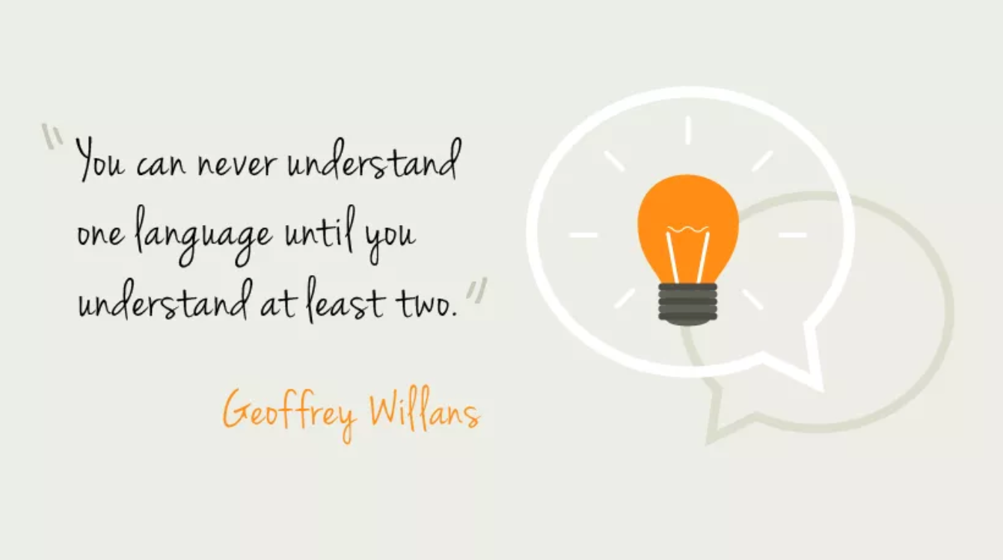
5. Get better at what you already do
Notes:
“You can never understand one language until you understand at least two.” Geoffrey Willans
https://en.wikipedia.org/wiki/Geoffrey_Willans
“He who knows no foreign languages knows nothing of his own.” Johann Wolfgang von Goethe

Slide 9
Resources
Python.org
PyPi.org
Cython.org
Talkpython.fm
Realpython.com
Meetup

